Slide 1
Ensuring Low-Income Students Access the Opportunities They Have Earned
Jessica Howell
Jonathan Smith

Slide 2
Policy Research at The College Board
Interdisciplinary team
Economics, education, measurement, political science, psychometrics, public policy, sociology
Team goals
Identify and conduct rigorous social science research
Help organization to implement evidence-based activities at scale
Evaluate whether initiatives worked and for whom
Ensure College Board practices, policies, and policy positions are supported by evidence
Today
Delicate mix of research overview and research specifics
2

Slide 3
Access to Opportunity
New College Board “program” charged with addressing large gaps in college enrollment, persistence, and completion by income, race/ethnicity, and first generation status.
SAT and AP are examples of other College Board programs, so mission has been explicitly elevated.
Barriers that cause these gaps include issues of:
Affordability
Academic preparation
Process complexities and information asymmetries
Various policies and practices
Policy Research team is the research arm for Access to Opportunity
3

Slide 4
Access to Opportunity: Sample of Evidence-Based Initiatives
Realize Your College Potential
Based on Expanding College Opportunities research by Hoxby & Avery (2013), and Hoxby & Turner (2013)
Targets high-achieving, low-income students with info about balanced application portfolio, affordability, and good match/fit
Apply to 4 or More
Based on application and enrollment research by Smith (2013), Pallais (2013)
Targets students on-track for college with college app fee waivers and messaging about applying to enough colleges
All In
Based on AP effectiveness research by Jackson (2010) and Smith, Hurwitz, & Avery (2015), and descriptive statistics in AP Report to the Nation (2015)
Targets African American, Latino, and Native American students with outreach about enrolling in AP courses in which they have potential for success
One of a variety of very targeted AP expansion/access pilots
4

Slide 5
Outreach via Social Media
Mounting evidence that small behavioral nudges and reminders can have measurable impact…even in education
Lavecchia, Liu, and Oreopolous (2015)
College Board has series of “pilot” experiments
Primarily using Facebook
Several different asks
Registering for SAT, sending SAT scores and college applications, general college planning, college course registration and payment
Several groups of students
Low-income, middle-income, community college students
Several partners involved
Community colleges, Harvard’s Center for Education Policy Research and other external researchers, numerous College Board teams
5

Slide 6
Why Facebook?
Great reach
Can use student email addresses to advertise (custom-audience)
Ads can be extremely targeted
Facebook has been shown to matter in other contexts
Emotional and voting experiments
Ads are relatively inexpensive
Return to online ads is open question (Blake, Nosco, and Tadelis, 2014))
However, notoriously low click-through rates
But perhaps exposure has an effect?
Open question as to how online platforms affect offline behavior
Need an experimental design
6

Slide 7
General Experimental Design
Find College Board students whose behavior we want to influence
Select students with valid email addresses
Determine whether they have opted-in to receive info from us
Approximately 50% of students
Randomize students into control and treatment groups
Upload emails to Facebook
Approximately 50% of emails can be found
We do not know which emails are found → ITT estimates
Send ads to students
Facebook sends aggregated report on ad exposure and clicks
We can also track if student clicks
Observe outcomes in College Board data (clicks not necessary)
7

Slide 8
Experiment #1
Can we get low-income students, who are academically “on-track” for college and who have taken the SAT once before, to re-take the SAT in the fall?
On average, students improve by about 20 SAT points
Targeted two types of students
Used SAT fee waiver the first time took SAT
Did not use an SAT fee waiver the first time (but may be income-eligible)
Approximately 13,000 students in each treatment group
10,000 in control group
Ads went online and to mobile
Bid extremely high, to get maximum exposure
Facebook has limits on how often an ad can be seen in a day
8

Slide 9
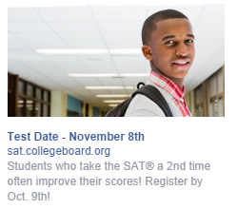
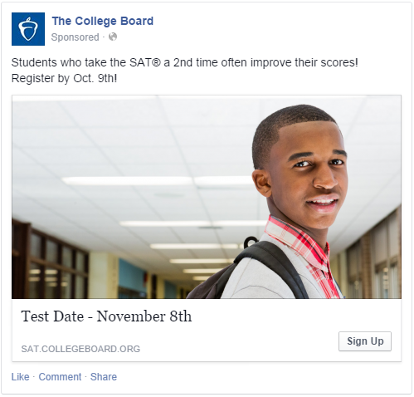
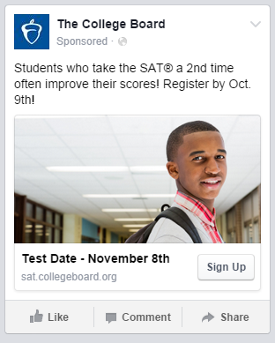
Experiment #1

Slide 10
Experiment #1 Results
Among students in treatment group (who were found in Facebook)
Approximately 80,000 “impressions”
Some students don’t ever see ad
Lots of exposure!
Approximately 200 ad clicks
0.24% click-through rate…pretty low!
Cost approximately $400
Relative to control group
No overall effect on whether registered or took SAT a second time
Signs of effects for fee waivered females (2 p.p. → 25 percent)
Females more likely to see ads
Running related ad for low-income PSAT-takers to take SAT in spring of their junior year
10

Slide 11
Experiment #2
Partnered with two community colleges
Received list of students (and their emails) who have not taken all necessary steps for coming semester and are either:
First-time enrollees, but in system (i.e., summer melt)
Continuing students without degree (i.e., persistence)
Treatment students saw cycled ads over course of few weeks
Apply for financial aid
Choose courses
Pay tuition
Combination of tasks
No results yet!
11

Slide 12
Experiment #3
Middle-income students’ college application patterns more similar to low-income peers than high-income students
Can we get academically “on-track” middle-income students to complete important tasks and engage in college planning?
Complete FAFSA
Important application deadlines and checklist
How to create
Apply to 4 or More
SAT Score Sends
Links to College Board websites with more information
For subset of students, also used Twitter
Lower email match rate than Facebook
Can only track SAT Score Sends and college enrollment
12

Slide 13
Concluding Thoughts
13

Slide 14
Ensuring Low-Income Students Access the Opportunities They Have Earned
Jessica Howell (jhowell@collegeboard.org)
Jonathan Smith (jsmith@collegeboard.org)

